Slide 1


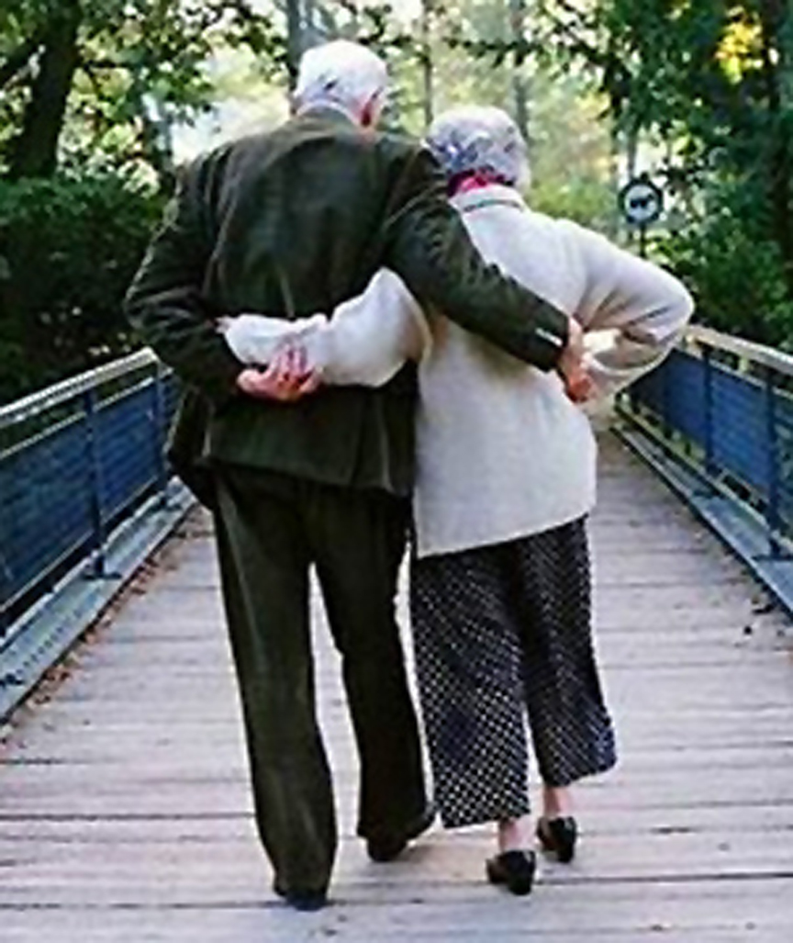
Married:
Growing & Serving Together
A Study of Marriage, Spring 2023

Slide 2
Class Introduction
The Content
  A Study of Marriage – Seeking to Better Understand God’s Purpose for Marriage and to Improve Our Marriages through Study & Application
  See Class Schedule

Slide 3
Class Schedule

Slide 4
Class Schedule, cont.

Slide 5
Class Introduction, cont.
Basis
  Primarily Scripture: rules and principles from the Architect of marriage
  Secondarily: learnings from our own marriages and personal studies as well as the experiences of others we have known or counselled
Approach
  A mix of lecture and class discussion
  Questions and comments are encouraged and expected
  Please submit any additional topics you would like to see discussed
  We are open to revising the planned class schedule
Expectations
  Serious, adult topics will be discussed candidly
  The class environment will be one where everyone feels comfortable participating
  Safe, loving and confidential discussion will be promoted
Commit to self improvement (not trying to improve your spouse)

Slide 6
Class Member
Introductions
Name, how long a Christian?
If Married, how long married?
Answers to “seed questions”
  e.g. How would you complete? “Marriage
  is _____________”

Slide 7
The Context for Marriage Today
DECLINING / POSTPONED | “SURPRISING” GOODNESS
Since 1960, divorce rate doubled | Married people have greater physical and mental health
In 1970, 89% of births to married parents, 1990: 72%, 2016: 60% | Married people have 75% more wealth at retirement
In 1960, 72% of adults were married, in 2008: 50%, 2022: 45% | Married men earn 10-40% more than single men with same education and jobs
1960’s, Median age for first marriage: 23 men / 20 women, In 2016: 30 men / 28 women | 60% of people say they are “very happy” in their marriages
In 1960, Cohabitation rate before marriage: nearly zero, Today >50% live together before they marry | 2/3 of unhappy married people become happy within 5 years if they stay together

Slide 8
Views of Marriage
TRADITIONAL (About US) | “MODERN” (About ME)
Permanent covenantal union | Terminable contract subject to the couple’s own wills & preferences
Mutual sacrificial love, procreation, protection | Individual gratification with a partner who makes life more interesting
Framework for growth through the duties of marriage & family | Finding a “compatible” partner who accepts you just as you are
Subordinating individual interests in favor of the relationship | Finding emotional and sexual fulfillment and SELF actualization
A public institution for social stability and the common good | A private arrangement for the satisfaction of individuals
FOR church, partner, children, society | FOR SELF
The “modern” view leads to search for a “compatible soul mate”

Slide 9
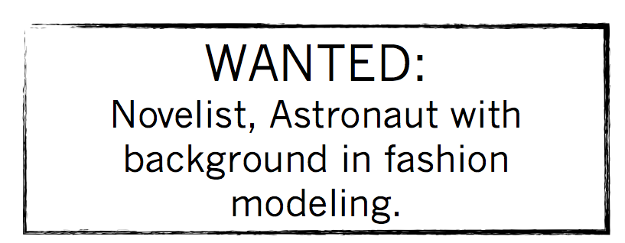
Modern “Pessimistic Idealism”
(Unrealistic expectations leading to pessimism toward marriage and finding the right spouse / soul mate)
In other words, people envision a spouse who is fun, intellectually stimulating, and sexually attractive; someone who will be “low maintenance” while supporting their personal goals and accepting the way they live and act now.

Slide 10
Marriage is…
  “Marriage is a lifelong, monogamous relationship between a man and a woman…” devised by God “… to reflect His saving love for us in Christ, to refine our character, to create stable human community for the birth and nurture of children, and to accomplish all this by bringing the complementary sexes into an enduring whole-life union.”
  - Keller, Timothy; Keller, Kathy. The Meaning of Marriage . Penguin Publishing Group.

